Slide 1
ENERO 8, 2024
Filosofía y ciencia para tu bienestar

Slide 2


Caroline Cummins
MSc. Reg. Nutricionista
Gerente Global de Comunicaciones Científicas
Marlene Nordlander
MSc. Reg. Dietista
Entrenadora Global Wellness Senior
Isabella Lee Tillander
PhL. Nutricionista
Científica Nutricional Global Senior
Notes:
SCRIPT:
The Nutrition Council helps;
Guide product development
Provide nutrition education and training to markets
Guide marketing communications
Define the nutritional philosophy across the business
Speak at Wellness events
Caroline, Marlene and Isabella introduces themselves

Slide 3
Bienestar
Notes:
SCRIPT:
Let me tell you a story, a story about how Wellness and wellbeing always have been a big part of Oriflame.

Slide 4

1967
Los hermanos af Jochnick fundaron Oriflame
Notes:
SCRIPT:
In 1967 the brothers, Jonas and Robert af Jochnick, founded Oriflame.
They’ve always had a passion for health and wellbeing and have constantly lived a holistic Swedish healthy lifestyle and recognised that it gave them the energy, drive and mental strength to fuel their ambitions and drive them to success, and passionately believed this was something that should be shared with the world.
Their holistic healthy lifestyle is now a living legacy.
A legacy that is passed on to their children, grandchildren and even to Oriflame.

Slide 5

Notes:
SCRIPT:
In 2008, Oriflame’s own Wellness category – Wellness by Oriflame – came to life, with nutritional products like the Natural Balance Shake and the WellnessPack, to support the wellbeing of people.

Slide 6








2008
9
Productos
9
Países
6
Notes:
SCRIPT:
It started out with a quite limited number of products, only available in a few markets.

Slide 7

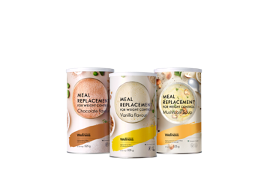

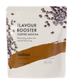

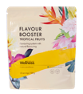







2022
27
Productos
54 Países
7
Notes:
SCRIPT:
This last few years, we have launched a lot of new products! Like a completely new segment, with the launch of our Meal Replacement products, to help people reach their dream weight.
So, what would be the next step?

Slide 8
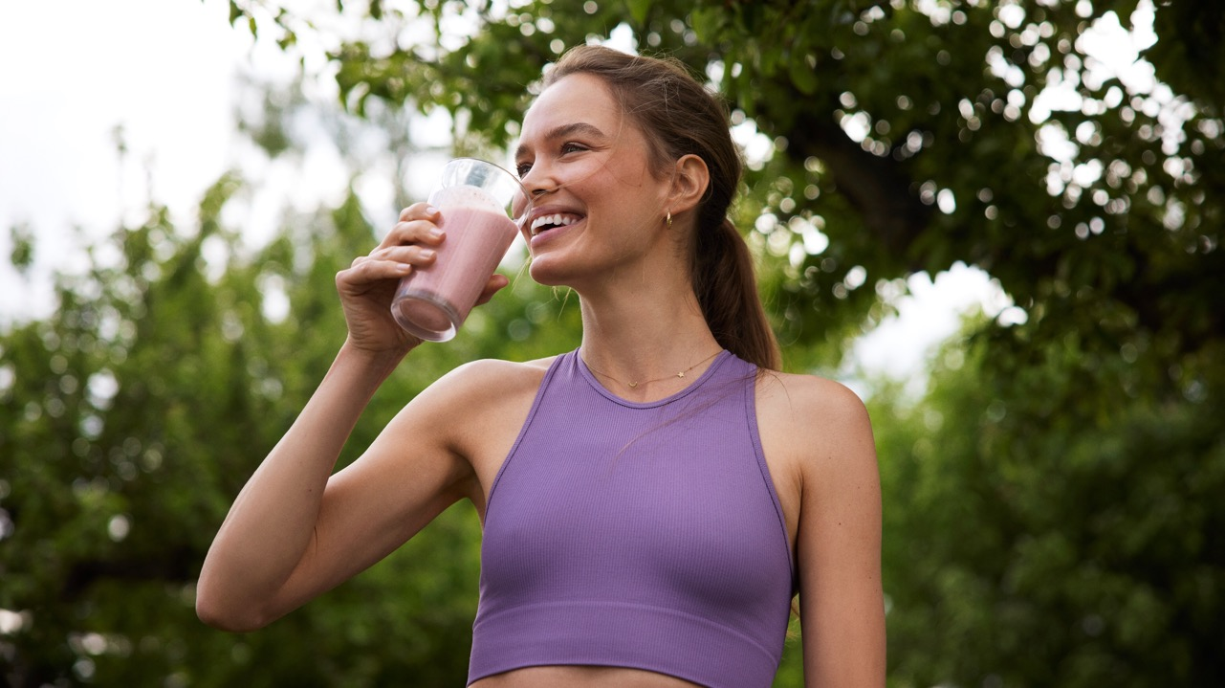
‘La definición de “estar saludable” continua evolucionando.’
EUROMONITOR 2022
Notes:
SCRIPT:
When we are talking to leaders like you and reading big trend reports we see a clear message - that health, and being healthy, is not longer just about eating right, or having a fit body, it is evolving.
Most people feel that health encompasses physical as well as mental wellbeing and personal happiness.
So we took a look at what we believe in, what our philosophy is.

Slide 9



NUESTRA FILOSOFÍA DE BIENESTAR
BIENESTAR POR DENTRO Y POR FUERA
GUIARTE A UNA VIDA BIEN EQUILIBRADA
SOLUCIONES HOLÍSTICAS DE PRODUCTOS
Notes:
SCRIPT:
And, these three pillars are what we knew we wanted to be able to offer you.
It is the commitment to help people take a holistic and balanced approach to their wellbeing!
It can make all the difference in them not just reaching their wellbeing goals but sustaining them and going beyond - true wellbeing for life!
This means a greater focus on offering a complete product solution that is based on credible scientific evidence.

Slide 10

BIENESTAR POR DENTRO Y POR FUERA
NUTRICIÓN
PIEL
ACTIVIDAD FÍSICA
RUTINA DE BELLEZA DIARIA
EMOCIONES
SUEÑO
CONEXIÓN SOCILA
Notes:
SCRIPT:
Wellbeing outside and inside means that we believe in a holistic approach when it comes to your wellbeing.
Daily routines of different aspects such as a balanced diet, physical activity, sleep, social connection, mental wellbeing and beauty supports your wellbeing and beauty from the inside out and the outside in.
You decide which aspect is most important for your wellbeing.
We have the knowledge and tools to support you with all of them.

Slide 11
NUESTRA FILOSOFÍA DE BIENESTAR
BIENESTAR POR DENTRO Y POR FUERA
GUIARTE A UNA VIDA BIEN EQUILIBRADA
SOLUCIONES HOLÍSTICAS DE PRODUCTOS
Notes:
SCRIPT:
And, these three pillars are what we knew we wanted to be able to offer you.
It is the commitment to help people take a holistic and balanced approach to their wellbeing!
It can make all the difference in them not just reaching their wellbeing goals but sustaining them and going beyond - true wellbeing for life!
This means a greater focus on offering a complete product solution that is based on credible scientific evidence.

Slide 12

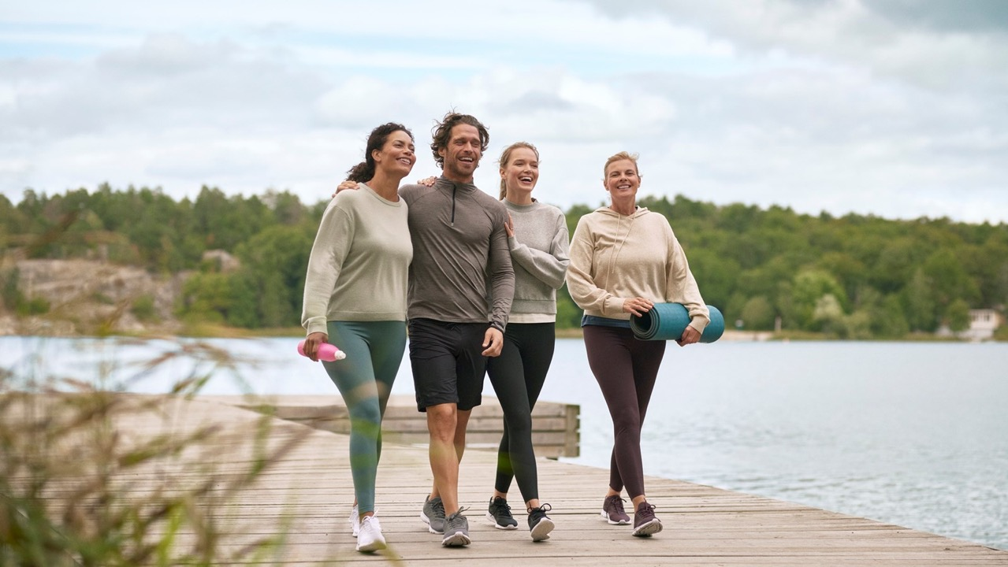

GUIARTE A UNA VIDA BIEN EQUILIBRADA
Notes:
SCRIPT:
Guiding you to well-balanced living is all about bringing the knowledge and support on how to live a balanced healthy lifestyle.
And that we do for instance through our Wellness Clubs.

Slide 13
NUESTRA FILOSOFÍA DE BIENESTAR
BIENESTAR POR DENTRO Y POR FUERA
GUIARTE A UNA VIDA BIEN EQUILIBRADA
SOLUCIONES HOLÍSTICAS DE PRODUCTOS
Notes:
SCRIPT:
And, these three pillars are what we knew we wanted to be able to offer you.
It is the commitment to help people take a holistic and balanced approach to their wellbeing!
It can make all the difference in them not just reaching their wellbeing goals but sustaining them and going beyond - true wellbeing for life!
This means a greater focus on offering a complete product solution that is based on credible scientific evidence.

Slide 14


SOLUCIONES HOLÍSTICAS DE PRODUCTOS
EFICIENTES
RESPONSABLES
SEGUROS
WELLBEING OUTSIDE & INSIDE
GUIDING YOU TO WELL-BALANCED LIVING
Notes:
SCRIPT:
Holistic product solutions, means that we have products for different personal needs to match a holistic approach to wellbeing.
And we ensure that all products are performing, safe and responsible.
Caroline will tell you more about this shortly.

Slide 15


Wellosophy
WELL
BEING
PHIL
OSOPHY
Notes:
SCRIPT:
And then we realised that we where on the way to something big with our new philosophy of Wellbeing.
That Wellness by Oriflame also needed to evolve. That is why we have created WELLOSOPHY.

Slide 16
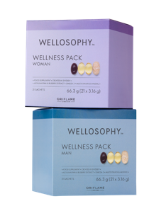
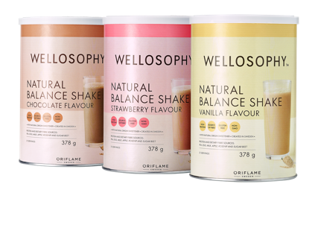
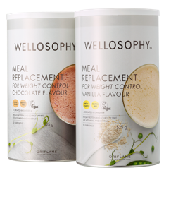
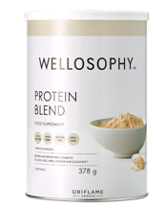
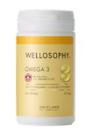


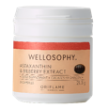
Notes:
SCRIPT:
So, last year we started to relaunch the Wellness products, that you know and love in a new more modern suit.
And in the future we will launch new product categories within the Wellosophy brand, to become a truly holistic brand.

Slide 17
#mywellosophy
Notes:
SCRIPT:
We want to create a buzz and a movement around our wellbeing philosophy with the campaign - My Wellosopy.
Building on the legacy of the founding af Jocknick family and their holistic lifestyle we want you to share your Wellosophy both face-to-face and in your social media channels.
Remember to hashtag with #mywellosopy

Slide 18

Notes:
SCRIPT:
Let’s watch what Robert af Jochnick’s wellosophy is!

Slide 19
Nuestra Filosofía Nutricional

Slide 20

Primero y ante todo,
​
​
​
Los suplementos nutricionales deben consumirse como parte de una dieta equilibrada
Nuestros suplementos nutricionales no están destinados a personas enfermas.
Nuestras vidas ocupadas a veces pueden obstaculizar los buenos hábitos, por lo que reconocemos una oportunidad en los suplementos nutricionales para complementar la dieta diaria*
* Los suplementos nutricionales no deben utilizarse como sustitutos de una dieta equilibrada y variada.
Notes:
SCRIPT:
At Wellosophy, we believe first and foremost in encouraging a healthy lifestyle, which includes a varied and balanced diet and plenty of water.
Nutritional supplements should be consumed as part of a balanced diet, to support the overall health of consumers.
The science we use to develop our nutritional supplements is based on healthy populations. Those who suffer from diseases may have different needs. Our nutritional supplements are not intended for sick people
Our busy lives can sometimes get in the way of good habits, which is why we recognise an opportunity for nutritional supplements to complement the daily diet* in a convenient format

Slide 21
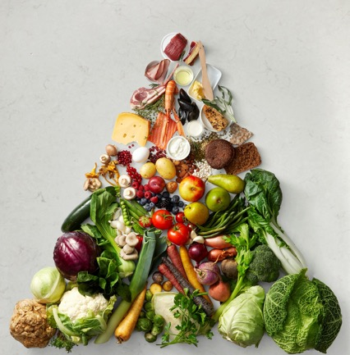


Filosofía Nutricional
Todo lo que hacemos, desde nuestros consejos sobre nutrición y estilo de vida, hasta el desarrollo de nuestros productos alimenticios y suplementos, se guían por nuestra filosofía nutricional.
Inspirados por los Principios de la Dieta Nórdica
Respaldado por la Ciencia más reciente
Nutrición Sustentable
Notes:
SCRIPT:
Everything we do, from our nutrition and lifestyle advice, to the development of our food products and supplements, is guided by our nutrition philosophy.
We are inspired by the principles of the Nordic Diet, our products and advice are underpinned by the latest nutrition science, and we strive for sustainable nutrition.

Slide 22
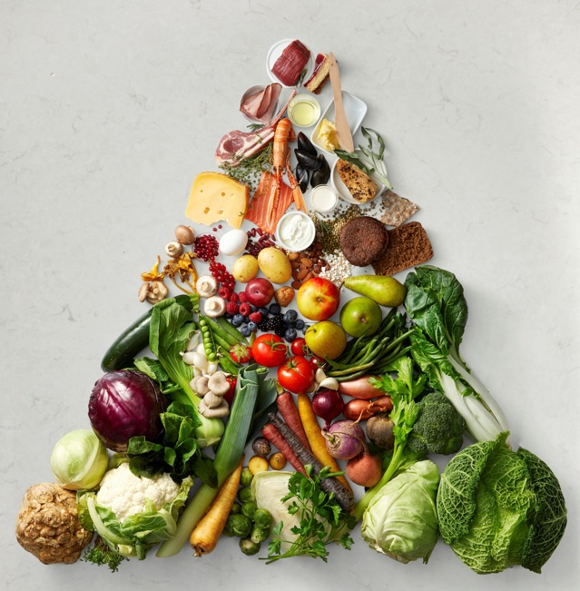
Inspirado por los Principios de la Dieta Nórdica
Fortificación positiva de nutrimentos que promueven la salud.
Limitar los nutrimentos cuya ingesta elevada esté relacionada con problemas de salud.
Ingredientes de la Dieta Nórdica
Deliciosa experiencia sensorial
Ingredientes naturales y sin OGM siempre que sea posible.
Notes:
SCRIPT:
The Nordic Diet is a way of eating that focuses on locally sourced, seasonal, whole foods in the Nordic countries including Sweden. Like the Mediterranean Diet, the Nordic Diet is renowned for its many health benefits.
The principles of the Nordic Diet promote nutrients that we aren’t eating enough of, or in the right pattern, like protein, dietary fibre, omega-3, vitamins, minerals and phytonutrients.
It limits nutrients where high intakes are linked with health problems – like excess calories, saturated fat, salt and sugar.
We like to include Nordic Diet ingredients such as berries, fruit, vegetables, wholegrains within many of our formulations.
We believe you should love your daily routine and so we strive to offer a truly delicious sensory experience.
We opt for non-GMO and natural ingredients where possible.

Slide 23
Filosofía Nutricional
Todo lo que hacemos, desde nuestros consejos sobre nutrición y estilo de vida, hasta el desarrollo de nuestros productos alimenticios y suplementos, se guían por nuestra filosofía nutricional.
Inspirados por los Principios de la Dieta Nórdica
Respaldado por la Ciencia más reciente
Nutrición Sustentable
Notes:
SCRIPT:
Everything we do, from our nutrition and lifestyle advice, to the development of our food products and supplements, is guided by our nutrition philosophy.
We are inspired by the principles of the Nordic Diet, our products and advice are underpinned by the latest nutrition science, and we strive for sustainable nutrition.

Slide 24

Respaldado por la Ciencia más Reciente
Los productos se desarrollan de acuerdo con las pautas nutricionales internacionales.
Los bioactivos están respaldados por la ciencia
Diseñado para satisfacer las necesidades nutricionales.
Dosis óptima para ofrecer beneficios de salud comprobados
Seguro y conforme
Guiado por el Consejo de Nutrición y, si es necesario, por un Consejo Asesor Científico independiente
Notes:
SCRIPT:
Our products are developed according to international nutrition guidelines.
Bioactives are underpinned by the most up to date science
Tailored to local & personal nutrition needs
Ingredients and bioactives are delivered at the optimal dose to deliver proven health benefits
Our products are designed to be safe and compliant. We follow internationally recognised standards, including those from the European Food Safety Authority, along with local regulations, to ensure our products are safe and meet international food safety standards. It can take up to 24 months to guarantee high-quality and safety in our products
Our nutrition research and product development are guided by the experts in our own Nutrition Council. In addition, our independent Scientific Advisory Board bring the latest research from their own specialist fields. This ensures the highest scientific rigor behind everything that we do.

Slide 25
Filosofía Nutricional
Todo lo que hacemos, desde nuestros consejos sobre nutrición y estilo de vida, hasta el desarrollo de nuestros productos alimenticios y suplementos, se guían por nuestra filosofía nutricional.
Inspirados por los Principios de la Dieta Nórdica
Respaldado por la Ciencia más reciente
Nutrición Sustentable
Notes:
SCRIPT:
Everything we do, from our nutrition and lifestyle advice, to the development of our food products and supplements, is guided by our nutrition philosophy.
We are inspired by the principles of the Nordic Diet, our products and advice are underpinned by the latest nutrition science, and we strive for sustainable nutrition.

Slide 26

Nutrición Sustentable
Los productos son de alta calidad nutricional.
Se promueven fórmulas e ingredientes a base de plantas.
Ingredientes sostenibles siempre que sea posible
Notes:
SCRIPT:
Sustainable nutrition is healthy nutrition for both people and the planet.
We ensure that our products are of high nutritional quality and contribute to good health.
Plant based formulas are promoted in food and we strive to use plant-based ingredients and alternatives where possible.
We always opt for the more sustainable choice when it comes to ingredients where technically feasible

Slide 27


¿Cómo implementamos nuestra Filosofía Nutricional
NUTRICIÓN
EFICIENTE
PIEL
ACTIVIDAD FÍSICA
RUTINA DE BELLEZA DIARIA
RESPONSABLE
SEGURO
EMOCIONES
SUEÑO
Nutrition Center Of Expertise | Oriflame Cosmetics
CONEXIONES SOCIALES
Notes:
SCRIPT:
The Nutrition Philosophy serves as a tool in innovation and new product development alongside our Product Development Pillars (PDP)
It forms the scientific basis and approach to our communication and education initiatives
Our Wellosophy for true wellbeing focuses on having daily routines, with a holistic approach, including nutrition, physical activity, sleep, social connection, emotions and skin
Our holistic approach is brought to life through our Wellosophy Academy and Clubs. The Wellness Clubs support the achievement of health goals through inspiration, education and community support.
We will also be launching a Wellosophy Digital Centre of Expertise. All content is straight from our scientists to you and will include more information on our nutrition philosophy and our scientists. You will find scientific articles on Skin Health, Gut Health and Emotional Health. We will be constantly adding more content to this website and this year you can look forward to articles on Women’s Health and expert videos from our Nutrition Council and Scientific Advisory Board.

Slide 28





Consejo Asesor Científico
Asesores independientes reconocidos internacionalmente en nutrición y salud.
Dr. Frida Fåk Hållenius
Profesor Asociado
PhD
Experto en microbioma intestinal
Dr. Claude Marcus
Profesor
MD
PhD
Experto en prevención y tratamiento de la obesidad
Dr. Brendan Egan
Profesor Asociado
PhD
Experto en nutrición deportiva y envejecimiento saludable
Notes:
SCRIPT:
We are also delighted to have an independent Scientific Advisory Board, formed in 2022
The Scientific Advisory Board is comprised of independent advisors who are recognised leaders internationally in nutrition and health
We have three members on the Scientific Advisory Board:
Dr Frida Fak Hållenius is Associate Professor of Molecular Nutrition at Lund University in Sweden. Her research explores how food can modulate the gut microbiome, with a focus on the prevention of metabolic and neuroinflammatory conditions.
Dr Claude Marcus is Professor of Paediatrics at Karolinska Institute in Sweden. His research covers the full spectrum of obesity challenges from prevention to treatment, including behavioural change and the treatment of obesity-related disease.
Dr Brendan Egan is Associate Professor of Sport and Exercise Physiology at Dublin City University in Ireland. His research focuses on the synergy between nutrition and exercise interventions on both physical and cognitive performance across the life course, ranging from athletes to older adults.
These members work closely with us in the internal Nutrition Council and we meet in person at least twice a year.

Slide 29
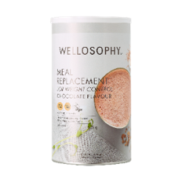
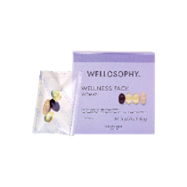
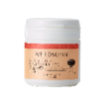
¡Profundicemos en estos productos Wellosophy!
Notes:
SCRIPT:
So, we can’t have a presentation without looking at some of our great Wellosophy products rights?

Slide 30


Our product development process
Briefing
Identificación del proveedor
Selección de ingredientes
Refinamiento de la fórmula
Modificaciones de sabor
Pruebas de consume (socios y líderes)
Reelaboraciones
Pruebas de seguridad y vida útil
Ajustes de cumplimiento
Control de seguirdad
Creación de comunicación
Idea
¡Lanzamiento de producto!
24 meses
Notes:
SCRIPT:
I want to start by showing you the product development process.
There is quite a team effort behind the development of our nutritional products.
We do all of these steps to make sure that we have a functional and performing product.
It starts with an ideation stage, followed by a concept brief from marketing to R&D. Oftentimes there is co-creation between marketing and R&D, especially when it comes to innovation projects.
We make sure to find the best suitable partners to support our product development.
The ingredient selection is also a very high priority to us as we want to ensure good quality ingredients and products.
We don’t just develop everything as per our own preferences, we also make sure to align concept, flavour, texture and other features with you Brand Partners.
Building understandable communication and trainings on our products is important, so that we have a successful product launch!
[CLICK] This entire process from start to finish can take up to 24 months.

Slide 31
Meal Replacement Shakes & Sopa
Notes:
SCRIPT:
One nutritional product that we worked especially hard in developing, is the Meal Replacement for Weight Control.
It was a great effort from the whole team in marketing, R&D, formulations and REG, and we are super proud of the results, and hope you are too!
So why develop a meal replacement product? Well, the next slide will give you a pretty clear picture of the problem that we are facing across the globe.

Slide 32






El sobrepeso y la obesidad son grandes amenazas globales para la salud
Inflamación crónica
Enfermedades respiratorias
Enfermedad cardiovascular
Ataque fulminante
Cáncer
Diabetes tipo 2
Muerte prematura
Osteo-artritis
39%
Sobrepeso u obeso
De la población adulta del mundo
Mexico
Sobrepeso u obeso 64.9%
Obeso 28.4%
Colombia
Sobrepeso u obeso 59%
Obeso 22.1%
Ecuador
Sobrepeso u obeso 56%
Obeso 19.3%
Peru
Sobrepeso u obeso 57.5%
Obeso 19.1%
Chile
Sobrepeso u obeso 63.1%
Obeso 28.8%
13%
obeso
De la población adulta del mundo
Año 2016
Se define sobrepeso como tener un Índice de Masa Corporal (IMC) igual o superior a 25 y obesidad se define como tener un IMC igual o superior a 30.
Notes:
SCRIPT:
The biggest threat to public health is the global epidemic of overweight and obesity.
Globally, about 4 out of 10 adults are overweight or obese.¹ Of which 13% are classified as obese. And the number keeps increasing.
Unfortunately, it’s not only adults that are affected. About 40 million children under the age of 5 are overweight or obese.
[CKLICK] What about the share of adults who are overweight or obese in Latin America?
If taking an average across the LATAM markets, 60% of adults are overweight or obese, and 24% are obese.
This is actually much worse than the global average, and we need to work together to change the projection.
[CLICK] Obesity is a risk factor for different diseases, like cardiovascular disease and cancer, and is responsible for almost 5 million premature deaths each year.
The risk of these diseases increases even when a person is only slightly overweight and grows more serious with every excess kilo.
The good news is that overweight and obesity are largely preventable.
The key to success is to find a balance between calories consumed and calories used.
Reference:
WHO (2018) – Fact sheet – Obesity and overweight. Updated February 2018. Online: https://www.who.int/en/news-room/fact-sheets/detail/obesity-and-overweight
Ritchie H & Roser M (2017) - “Obesity” Published online at OurWorldInData.org. Retrieved from: 'https://ourworldindata.org/obesity' [Online Resource]

Slide 33
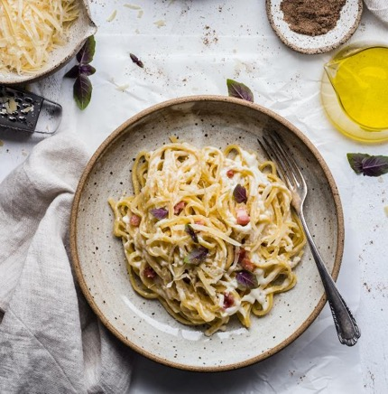

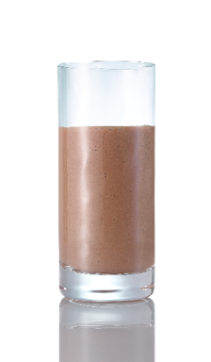
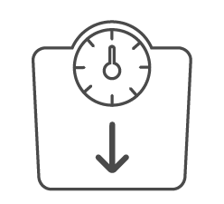
Being in a calorie deficit is the only way to lose weight!
How can a meal replacement for weight control support?
500
kcal
En promedio
200-250 kcal
To help control calorie intake
- 500 kcal
Déficit diario
>50%
kcal
x 2
Al día
Algunas comidas mucho más alto !
>1000 kcal
- 0.5 kg
A la semana
Notes:
SCRIPT:
The driver of overweight and obesity is being in an energy surplus, either by consuming more calories than needed or by not expending enough calories.
There is no food nor macronutrient that is innate fattening nor innate slimming; it is the total calories consumed and expended that decides your body weight¹. If you’re not in a calorie deficit, you will not lose weight – as simple as that.
In general, to lose 0.5 kg of fat per week you need to consume a deficit of 500 kcal per day (0.5 kg of fat contains approx. 3500 kcal).
But in a world where we have access to food around the clock, it can be hard to monitor the calorie intake.
[CLICK] Usually, main meals such as breakfast, lunch, or dinner, contain approximately 500 calories.
Certain types of meals can contain even more. A pizza for instance, can contain more than 1000 calories.
It can be tempting to skip an entire meal but then you risk not getting important nutrients for your wellbeing.
[CLICK] Instead, a simple way to control your calorie intake, without counting calories, is to use a nutritious meal replacement. Meal replacements are designed to provide about half the calories of a regular main meal.
[CLICK] So, if you replace two main meals a day with a meal replacement you will cut around 500 kcal from your diet without risk cutting out healthy nutrients.
Which would result in about half a kilo of weight lost per week. Isn’t that great!
Reference:
Jakicic JM, Clark K, Coleman E, et al; American College of Sports Medicine. American College of Sports Medicine position stand. Appropriate intervention strategies for weight loss and prevention of weight regain for adults. Med Sci Sports Exerc. 2001 Dec;33(12):2145-56.

Slide 34


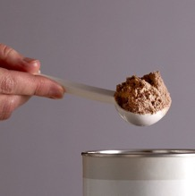




¿Por qué son efectivos los meal replacements?
Respaldado por la ciencia
Conveniente
Control de porciones
Nutritivo
Saciante
Fácil seguimiento
Estructurado
Adherencia a la dieta
Notes:
SCRIPT:
Why are meal replacements effective for weight control?^{1, 2, 3}
Let’s find out!
[CLICK] Backed by science. The use of Meal Replacements are proven by science to help you lose weight and keep the weight off.
[CLICK] Easy to prepare, convenient, time saving​
A barrier to losing weight is lack of time to prepare healthy meals. ​
[CLICK] Simple portion control​
[CLICK] Nutritious​
If not planned well, a calorie-restricted diet can result in a lower intake of important nutrients such as protein, dietary fibre, healthy fats, vitamins and minerals. Meal replacements are nutritious and ensure adequate amounts of important nutrients, while still low in calories.
[CLICK] Filling
Meal replacement formulations that are high in protein and dietary fibre can help to fill you up​.
[CLICK] Easy and accurate way to track calories throughout the day​
[CLICK] Regular and structured eating pattern​
Eating regularly helps regulate energy and hunger levels​.
[CLICK] Increased diet adherence​
As it is easier to plan meals, it is easier to stick to a meal replacement plan long-term, which is really the key to success.
References:
Astbury NM, Piernas C, Hartmann‐ Boyce J, Lapworth S, Aveyard P, Jebb SA. A systematic review and meta‐analysis of the effectiveness of meal replacements for weight loss. Obesity Reviews. 2019;20:569–587
EFSA Panel on Dietetic Products, Nutrition and Allergies (NDA); Scientific Opinion on the substantiation of health claims related to meal replacements for weight control (as defined in Directive 96/8/EC on energy restricted diets for weight loss) and reduction in body weight (ID 1417), and maintenance of body weight after weight loss (ID 1418) pursuant to Article 13(1) of Regulation (EC) No 1924/2006. EFSA Journal 2010;8(2):1466
Flechtner-Mors M, Ditschuneit HH, Johnson TD, Suchard MA, Adler G. Metabolic and weight loss effects of long-term dietary intervention in obese patients: four-year results. Obes Res. 2000 Aug;8(5):399-402.

Slide 35
¿Sabes cuántas dietas de adelgazamiento hace un adulto en promedio a lo largo de su vida?
126
Notes:
SCRIPT:
Do you know how many weight loss diets an average adult does in a lifetime?
[CLICK] The staggering number of 126 diets!!!¹
Let us lower that number, stop yo-yo-dieting and help people lose and maintain their weight once and for all by starting to use our Meal Replacement for Weight Control.
Reference:
StudyFinds. Food fads: The average adult will try 126 different diets during their life!. January 2020. https://studyfinds.org/food-fads-the-average-adult-will-try-126-different-diets-during-their-life/

Slide 36
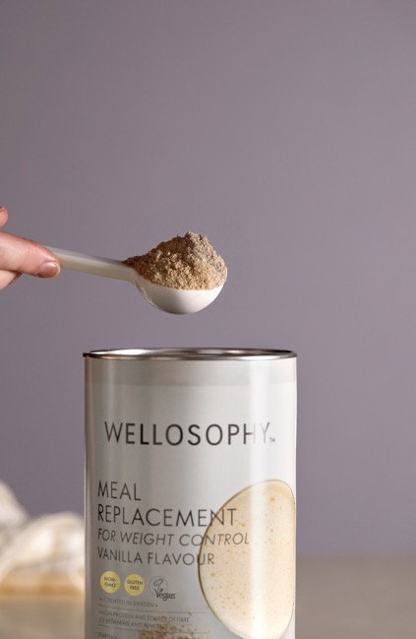
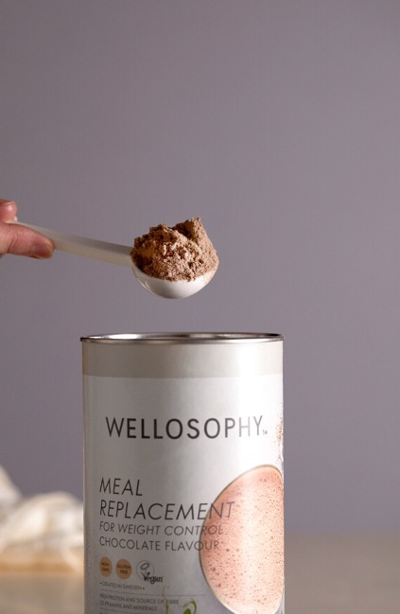
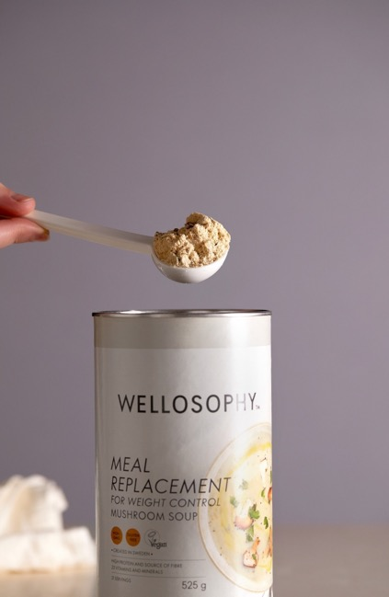
Meal Replacement for Weight Control
Características
Vanilla shake
21 porciones
Chocolate shake
21 porciones
Mushroom soup
21 servings
Energía
204-239
kcal
Energía
202-238
kcal
Energía
221-235
kcal
Proteína 20.2-20.6
grams
Proteina
20.3-20.7
gramos
Proteína
19.0-20.5
grams
Fibra
4.8-7.0
gramos
Fibra
4.5-6.7
gramos
Fibra
3.8-5.9
gramos
Vitaminas
13
Minerales
10
Vitaminas
13
Minerales
10
Vitaminas
13
Minerales
10
* One serving mixed with cow’s milk or soy milk alternative
Notes:
SCRIPT:
Our Meal Replacement for Weight Control shakes and soup come in cans of 21 servings, and provides a limited number of calories while still being as nutritious as a regular meal.
If you want a sweet and delicate taste – try the Meal Replacement for Weight Control Vanilla or Chocolate flavour!
And if you want a more savoury, warm and comforting soup – choose the Meal Replacement for Weight Control Mushroom Soup!
[CLICK] When mixed with cow’s milk, one serving provides about 200 kcal and if mixed with soy milk alternative it provides about 235 kcal. That’s around half the calories of a regular meal thanks to simple portion control.
[CLICK] They all contribute with around 20 g of protein and between 4-7 g of dietary fibre, depending on flavour.
[CLICK] On top of that, both the shakes and the soup contain 23 essential vitamins and minerals (13 vitamins, 10 minerals) to support a healthy weight loss.

Slide 37

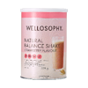









¿Cómo usar?
Siga siempre las recomendaciones de uso indicadas en el paquete.
Snack
CENA
DESAYUNO
Snack
LUNCH
Snack
CENA
DESAYUNO
Snack
LUNCH
PÉRDIDA DE PESO
MANTENIMIENTO PESO
Remplaza 2 comida principal/día con Meal Replacement para Control del Peso*
Remplaza 1 comida principal/ día
con Meal Replacement
Para Control de Peso**
AGUA
AGUA
* No debe ser combinado con la tableta multivitamina y minerales para M/H
** Puede ser combinado con la tableta multivitamina y minerals para M/H
Notes:
SCRIPT:
How should you use the Meal Replacement for Weight Control throughout the day then?
Well, it’s the perfect way to swap a main meal such as breakfast, lunch or dinner when you feel you need to control your weight. It’s convenient and easy to make which means less planning, less cooking and also a higher success rate.
The Meal Replacement for Weight Control can be used either once or twice per day, depending on your goal. But never exceed the recommended daily dose since it’s not a total diet replacer!
Let’s look at two examples of how to use it.
[CLICK] If you want to lose weight you replace two main meals per day with Meal Replacement for Weight Control* and eat one nutritionally balanced meal, based on the Plate model for weight loss where;
half of the plate is filled with veggies to contribute with high-volume yet low-calorie content. ​
one-fourth of the plate is filled with protein-rich and filling poultry, fish and legumes. Limit red meat. Avoid bacon and other processed meats.​
the last fourth of the plate is filled with fibre-rich carbohydrates like brown rice, wholegrain pasta, wholegrain bread or potatoes.​
If you eat snacks in between main meals, it’s important to eat healthy snacks high in protein and fibre, such as Natural Balance Shakes accompanied by a fruit or a snack of your own choice.
The Wellness Pack cannot be bundled with Meal Replacement for Weight Control if being taken twice daily, since it would mean excessive intake of certain vitamins and minerals. But you can still use the Omega 3 and Astaxanthin & Bilberry capsules!
[CLICK] If you want a healthy nutritious meal in seconds and want to maintain your weight you replace one meal per day with Meal Replacement for Weight Control** and eat two nutritionally balanced meals, according to the Plate model for weight loss.
Same goes here for snacks - If you eat snacks in between main meals, it’s important to eat healthy snacks high in protein and fibre, such as Natural Balance Shakes accompanied by a fruit or a snack of your own choice.
When only using the Meal Replacement for Weight Control once a day, you can bundle it with Wellness Pack without getting excessive intake of certain vitamins and minerals.
[CLICK] Regardless if you want to lose or maintain your weight, it’s always important to maintain adequate water intake.
As a guiding value adults should drink 1-1.5 liters/day in general in addition to water that comes from food.
Foods provide an average of 1-1.5 liters/day as well (fruits, vegetables, yogurt, soups, etc.)
Always have your water bottle with you!
* Substituting two daily meals of an energy restricted diet with meal replacements contributes to weight loss
**Substituting one daily meal of an energy restricted diet with a meal replacement contributes to the maintenance of weight after weight loss

Slide 38
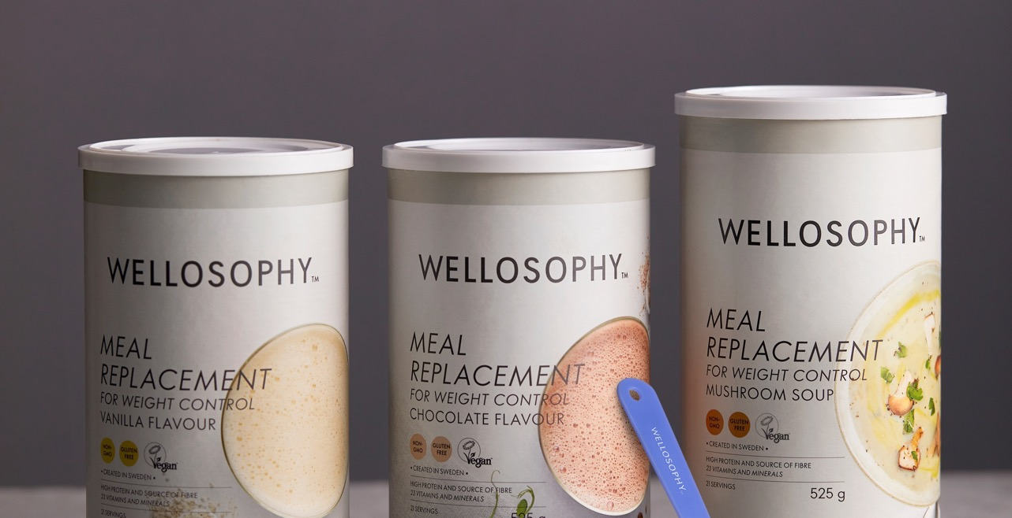

¿Qué es único con nuestro Meal Replacement para Control de Peso?
Cumplimos con los estrictos criterios de la UE ¡Y MÁS ALLÁ!
Ingredientes naturales y basados en plantas
Proteína completa
Fibra dietética saludable
Sin azúcar añadida
Saludable, vegano, ingredients bien pensados!
Comparison made on formula, not on prepared product
Notes:
SCRIPT:
Let’s finish off with what makes our Meal Replacement for Weight Control unique, if compared with other meal replacements on the market.
First off, we if course a bide by the strict EU criteria for how meal replacements should be composed.
But we go above and beyond the requirements with our Meal Replacement by:
[CLICK] Using natural and plant-based ingredients, which makes this product vegan and registered with the Vegan Society.
[CLICK] The protein sources we use, contain all essential amino acids that our body needs, making it a complete protein source. Ours is a mix of high-quality plant proteins from pea and faba bean instead of using cheaper sources.
[CLICK] The EU criteria say nothing about the carbohydrate quality. But we know that it’s important and made sure to include plenty of healthy dietary fibre, including the prebiotic fibre inulin that supports gut health.
[CLICK] And we don’t use any added sugar. Many competitors use sugar as a cheap way to increase the calorie content. But our main source of calories comes from protein. We were also restrictive with the use of thickeners and instead put effort into trying out different levels of ingredients for the right texture.
[CLICK] To summarise, our Meal Replacement for Weight Control is all about healthy, vegan-friendly, thoughtful ingredients! It is a convenient, nutritionally balanced and tasty solution that delivers lasting results.

Slide 39
Wellness Pack
Notes:
SCRIPT:
Another product that performs really well, is the Wellness Pack.
Before looking into the science and benefits behind the its different components, let’s find out why a product like this might be a good idea to add to your daily routine?

Slide 40
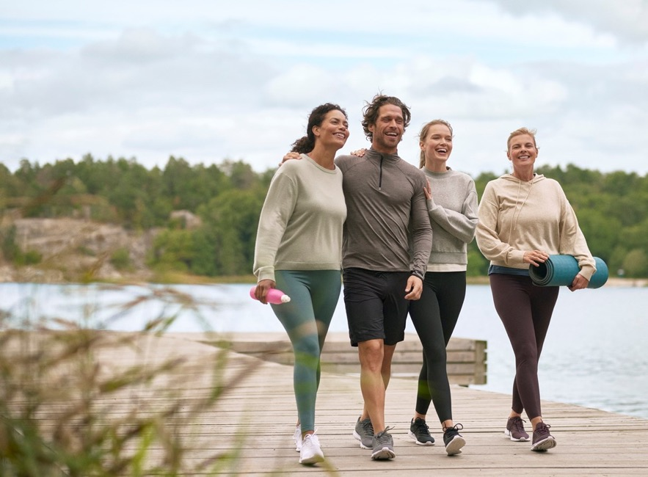
Una dieta nutritiva es fundamental para la salud
Notes:
SCRIPT:
We all know that a nutritious and varied diet, together with physical activity, is good for health and wellbeing.
And what’s the most important part of a nutritious diet? Well, most of us can automatically give the answer: fruits and vegetables. And not to forget the important omega 3 fatty acids.
But it can be tough to eat the daily recommended amount and one part of the problem is that it can be hard to understand how much we were talking about.
What do the recommendations say and do we consume enough to sustain long-term health?

Slide 41
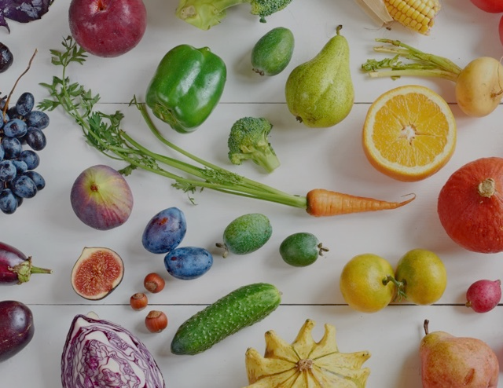







Frutas y vegetales
vitaminas │ mineraes │fitonutrimentos
Mexico
511.7 g
Fruta 337.92 g
Vegetales 173.78g
Colombia
507.17
Fruta 367.01 g
Vegetales 140.16 g
Ecuador
211.93 g
Fruta 152.10 g
Vegetales 59.83 g
Peru
509,32
Fruta 352.48 g
Vegetales 156.84 g
Chile
399.8 g
Fruta 200.93 g
Vegetales 198.87 g
Year 2020
RECOMMENDATION
ACTUAL INTAKE
Mexico
512 g
Colombia
507 g
Ecuador
212 g
Peru
509 g
Chile
400 g
Year 2020
Mínimo
400 gr
por día
Daily fruit intake
Global
<300 g
Por día
5x
Por día
Menos de
5x
78%
De adultos
Daily vegetable intake
Beneficia las funciones corporales y bienestar general
Notes:
SCRIPT:
[CLICK] The general recommendation is to consume at least 400 grams of fruits and vegetables daily¹, which roughly corresponds to 5 handfuls.
This the minimum amount to ensure enough vitamins, minerals and phytonutrients with antioxidative effect for our bodies to function properly.²
[CLICK] Although many people know about the general recommendations, only a small minority of the world’s population consumes the recommended intake.³
[CLICK] The global consumption of fruits and vegetables is less than 300 g daily, more specifically 290.1 grams.⁴
And a staggering 78% of adults consume less than the minimum recommended five daily servings of fruits and vegetables in low and middle income countries.⁵
This means that most people in the world are having trouble getting enough vitamins, minerals and phytonutrients in their diet.
And looking at the combined daily intake of fruit and vegetables in the LATAM countries, we can see that Ecuador could do better:⁶⁻⁷
References:
World Health Organization. Healthy diet. 2019: https://www.who.int/news-room/fact-sheets/detail/healthy-diet
WHO. Fact Sheet – Malnutrition. Geneva, World Health Organization, 2021. Available at: https://www.who.int/news-room/fact-sheets/detail/malnutrition.
WHO. Diet, nutrition and the prevention of chronic diseases. Report of a joint WHO/FAO expert consultation. Geneva, 28 January – 1 February 2002. WHO Technical Report Series; 916. Geneva, World Health Organization, 2003.
Micha R, Khatibzadeh S, Shi P, et al. Global Burden of Diseases Nutrition and Chronic Diseases Expert Group (NutriCoDE). Global, regional and national consumption of major food groups in 1990 and 2010: a systematic analysis including 266 country-specific nutrition surveys worldwide. BMJ Open. 2015 Sep 24;5(9):e008705.
Hall JN, Moore S, Harper SB, Lynch JW. Global variability in fruit and vegetable consumption. Am J Prev Med. 2009 May;36(5):402-409.e5
https://ourworldindata.org/grapher/average-per-capita-fruit-intake-vs-minimum-recommended-guidelines
https://ourworldindata.org/grapher/average-per-capita-vegetable-intake-vs-minimum-recommended-guidelines?tab=table

Slide 42
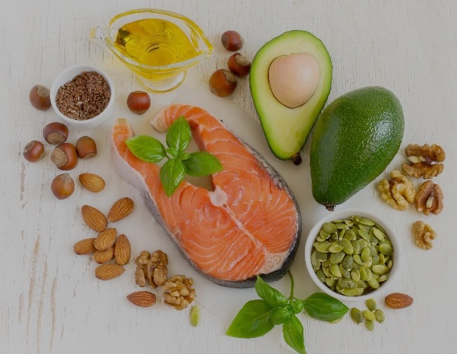
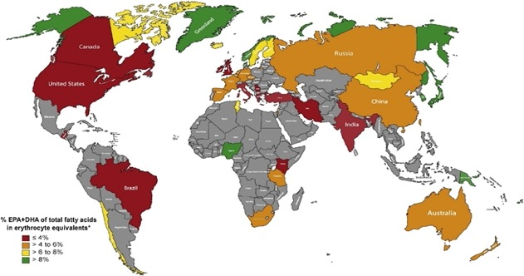



Omega 3 ácidos grasos
EPA (ácido eicosapentaenoico) │ DHA (Ácido docosahexaenoico)
RECOMMENDATION
ACTUAL INTAKE
Mexico
DHA 130.9 mg
Colombia
DHA 67.2 mg
Ecuador
DHA 86.6 mg
Peru
DHA 208.9 mg
Chile
DHA 141.1 mg
Year 2011
Mexico
131 g
Colombia
67 g
Ecuador
87 g
Peru
209 g
Chile
141 g
Year 2011
<200 mg DHA
250 mg
Por día
Global
<250 mg
Por día
2-3x
Por semana
EPA & DHA blood levels
DHA bajo
64%
De adultos
Beneficia la salud del corazón, cerebro, ojos y piel.
Notes:
SCRIPT:
[CLICK] Another recommendation is that most of the dietary fat should be unsaturated., which includes the important omega-3 fatty acids EPA (eicosapentaenoic acid) and DHA (docosahexaenoic acid) as these fats have proven benefits for heart³, brain⁴, eye⁵ and skin⁶.
The European Food Safety Authority (EFSA) recommends a daily intake of 250 mg of omega-3 fats. ¹
A simple way to consume this amount is to eat fish and seafood 2-3 times a week, which includes oily fish 2 of those times (ex. salmon, mackerel, herring).²
[CLICK] But the global intake of EPA and DHA is below the EFSA recommendation (250 mg/day) in most countries.⁷
When looking at the combined blood levels of EPA and DHA⁸, there are only few populations such as in Greenland, having sufficient levels.
And it is estimated that 64% of adults have a dietary DHA intake of less than <200 mg/day.⁹
This shows that most people need to increase their intake of omega-3 fats to support their health and wellbeing.
It is unfortunately hard to find data on the LATAM countries, which you can see here as they are coloured grey.
[CLICK] But in a research study that estimated the daily DHA intake on food supply data, showed that most of the LATAM countries, except Peru, were low in DHA. ⁹
DHA is especially important for brain and eye health and seafood is an important source in countries with access to a coastline, such as the LATAM countries.
The graph shows the sum of EPA and DHA in blood for healthy adults.
Red - Very low blood levels (≤ 4%) Very bad for health
Orange - Low blood levels (≤ 4 to 6%) Bad for health
Yellow – Moderate blood levels (> 6 to 8%) Okay for health
Green – High blood levels (> 8%) Very good for health
Gray – No data available
References:
EFSA Panel on Nutrition, Novel foods and Food allergens: Scientific Opinion on Dietary Reference Values for fats, including saturated fatty acids, polyunsaturated fatty acids, monounsaturated fatty acids, trans fatty acids, and cholesterol. 10.2903/j.efsa.2010.1461
Swedish National Food Agency. Swedish dietary guidelines. Rapport 5 – 2015
Djuricic I, Calder PC. Beneficial Outcomes of Omega-6 and Omega-3 Polyunsaturated Fatty Acids on Human Health: An Update for 2021. Nutrients. 2021 Jul 15;13(7):2421.
Schaefer EJ, Bongard V, Beiser A, et al. Plasmaphosphatidylcholine docosahexaenoic acid content and risk of dementia and Alzheimer disease: the Framingham Heart Study. Arch Neurol. 2006 Nov;63(11):1545-50.
Giannaccare G, Pellegrini M, Sebastiani S, et al. Efficacy of Omega-3 Fatty Acid Supplementation for Treatment of Dry Eye Disease: A Meta-Analysis of Randomized Clinical Trials. Cornea.2019 May;38(5):565-73.
McCusker MM, Grant-Kels JM. Healing fats of the skin: the structural and immunologic roles of the omega-6 and omega-3 fatty acids. Clin Dermatol. 2010 Jul-Aug;28(4):440-51.
Sioen I, van Lieshout L, Eilander A, et al. Systematic Review on N-3 and N-6 Polyunsaturated Fatty Acid Intake in European Countries in Light of the Current Recommendations - Focus on Specific Population Groups. Ann Nutr Metab. 2017;70(1):39-50.
Stark KD, Van Elswyk ME, Higgins MR, et al. Global survey of the omega-3 fatty acids, docosahexaenoic acid and eicosapentaenoic acid in the blood stream of healthy adults. Prog Lipid Res. 2016 Jul;63:132-52.
Forsyth S, Gautier S, Salem Jr N. Global Estimates of Dietary Intake of Docosahexaenoic Acid and Arachidonic Acid in Developing and Developed Countries. Ann Nutr Metab 26 July 2016;68(4):258–67.

Slide 43

¿Qué significa esto?
Las personas que no siguen una dieta saludable con suficientes frutas, verduras y mariscos podrían beneficiarse de la suplementación.
Notes:
SCRIPT:
So, what does this mean?
Well, it means that people who don’t eat a healthy diet comprised of enough fruits, vegetables, fish and seafood could benefit from obtaining vitamins, minerals, phytonutrients and the important omega-3 fatty acids - EPA and DHA - from supplements.

Slide 44

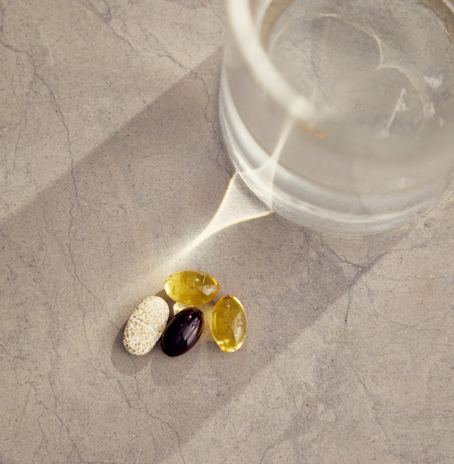

Wellness Pack
El producto
#1
En ventas en Oriflame
Cada sachet contiene:
2 x
Omega 3
1 x
Multivitamino y minerales
1 x
Astaxantina y extracto de arándano
Notes:
SCRIPT:
A great way to complement your diet is to take a daily sachet from the Wellness Pack.
Every year 43 million Wellness Pack sachets are being consumed across the world, making it Oriflame’s number-one selling product!
[CLICK] Every sachet contains:
1 x Multivitamin & Mineral tablet
1 x Astaxanthin & Bilberry Extract capsule
2 x Omega 3 capsules

Slide 45
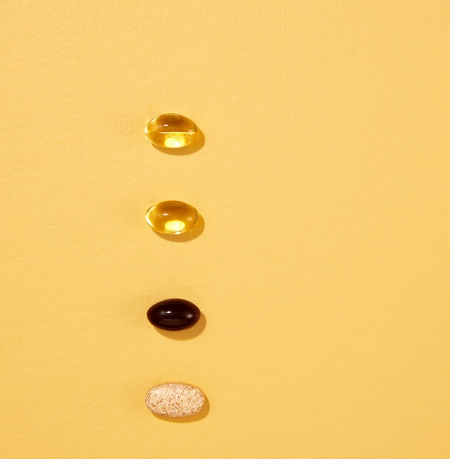
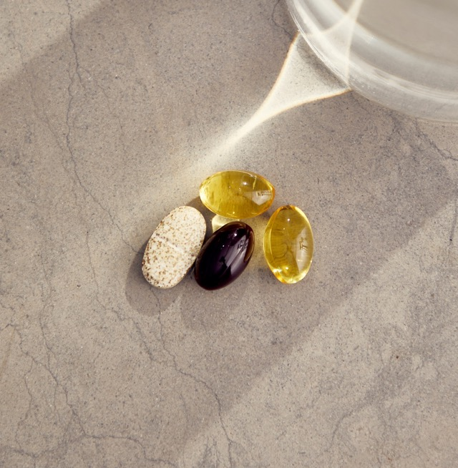



¿Por qué esta combinación de nutrimentos?
Los ácidos grasos omega-3 apoyan la membrana celular y la absorción de vitaminas y minerales.
Los antioxidantes ayudan a proteger los ácidos grasos omega-3 del estrés oxidativo
Una combinación de nutrimentos que trabajan en sinergia para apoyar el bienestar.
Las vitaminas y los minerales son parte de muchas funciones importantes dentro de la célula.
Notes:
SCRIPT:
But why do we have this specific constellation of components in the Wellness Pack?
[CLICK] Our scientists have combined these three supplements because they work in synergy to support overall health and wellbeing.
[CLICK] The antioxidants from the Astaxanthin & Bilberry Extract, help protect the omega-3 fatty acids from oxidative stress
[CLICK] And the omega-3 fatty acids support the cell membrane and the absorption of vitamins and minerals
[CLICK] And the vitamins and minerals are part of many important functions within the cell

Slide 46
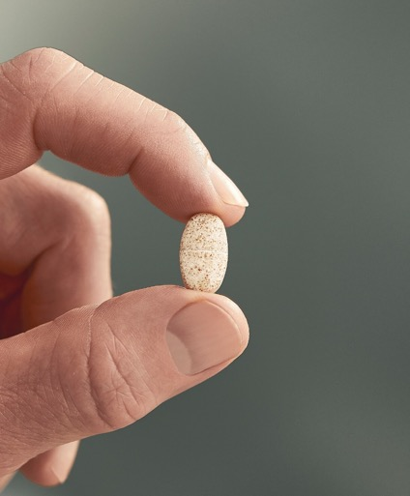
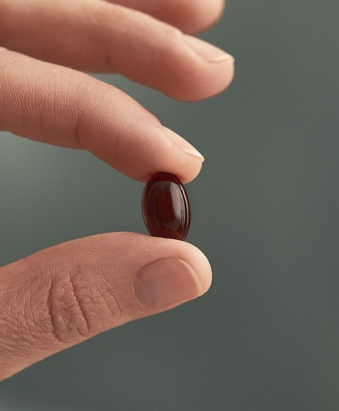
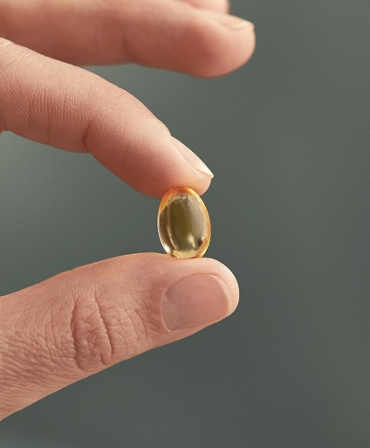
Wellness Pack
Features
Multivitamínico y minerales
tableta
Astaxantina y extracto de arándano
cápsula
Omega 3
cápsula
12
vitaminas
EPA
150 mg
Por 2 cápsulas
Astaxantina natural
3 mg
10
minerales
Extracto de arándano
50 mg
DHA
100 mg
Por 2 cápsulas
Vitamina C
12 mg
Vitamina E
1.8 mg
Notes:
SCRIPT:
Let’s look at the different components of the Wellness Pack!
First, we have the Multivitamin & Mineral tablet containing 12 essential vitamins and 10 essential minerals.
Secondly, we have the Astaxanthin & Bilberry Extract capsule that contains a broad spectrum of antioxidants from natural astaxanthin (3mg), bilberries (50 mg) and vitamin C (12 mg) and vitamin E (1.8 mg).
And last but not least, we have the Omega 3 capsules containing the important fatty acids EPA - eicosapentaenoic acid – (150 mg/2 capsules) and DHA - docosahexaenoic acid – (100 mg/2 capsules).
Let’s now take a deeper look into these three separate supplements!

Slide 47








Multivitamínico y minerales
Complies with
EC
authorised claims
- 22 vitaminas y minerales esenciales
12 VITAMINAS
Up to 100% EU NRV
Benefits
Vitamina
A
Vitamina
D
Vitamina
E
Vitamina
C
Tiamina
(B1)
Riboflavina
(B2)
Niacina
(B3)
Ácido Pantoténico
(B5)
Piridoxina (B6)
Biotina (B7)
Ácido fólico
(B9)
Cobalamina
(B12)
10 MINERALS
Calcio Ca
Yodo I
Cobre Cu
Hierro
Fe
Magnesio
Mg
Selenio
Se
Zinc Zn
Manganeso Mn
Cromo Cr
Molibdeno
Mo
Notes:
SCRIPT:
The Multivitamin & Mineral tablet contains 12 essential vitamins (3 fat-soluble and 9 water-soluble) and 10 essential minerals with up to 100% of the EU Nutrient Reference Value (NRV).
The amount of every specific vitamin and mineral is specifically formulated for men and women respectively.
[CLICK] The formulation complies with the European Commission authorised nutrition and health claims¹, which is one of the strictest regulations in the world.
The vitamins and minerals support the function of the immune system, metabolism, energy, muscles, bones, eyes, skin and also works as an antioxidant.
References:
EFSA Panel on Dietetic Products, Nutrition and Allergies (NDA); Scientific Opinion on the substantiation of health claims related to vitamin C and reduction of tiredness and fatigue (ID 139, 2622), contribution to normal psychological functions (ID 140), regeneration of the reduced form of vitamin E (ID 202), contribution to normal energy-yielding metabolism (ID 2334, 3196), maintenance of the normal function of the immune system (ID 4321) and protection of DNA, proteins and lipids from oxidative damage (ID 3331) pursuant to Article 13(1) of Regulation (EC) No 1924/2006. EFSA Journal 2010;8(10):1815. [20 pp.].
VITAMINS:
Vitamin A: Contributes to: normal function of the immune system, normal metabolism of iron, maintenance of normal skin, maintenance of normal vision.
Vitamin D: Contributes to: normal function of the immune system, normal muscle function, maintenance of normal bones, maintenance of normal teeth, normal absorption/utilisation of calcium and phosphorous.
Vitamin E: Contributes to protection of cells from oxidative stress.
Vitamin C: Contributes to: normal function of the immune system, normal energy yielding metabolism, protection of cells from oxidative stress, reduction of tiredness and fatigue, normal function of the nervous system, normal psychological function, normal collagen formation (for normal function of skin, gums, teeth, cartilage, bones, blood vessels).
Thiamine (B1): Contributes to: normal energy yielding metabolism, normal function of the heart, normal function of the nervous system, normal psychological function.
Riboflavin (B2): Contributes to: normal energy yielding metabolism, protection of cells from oxidative stress, maintenance of normal skin, reduction of tiredness and fatigue, normal function of the nervous system, maintenance of normal vision.
Niacin (B3): Contributes to: normal energy yielding metabolism, maintenance of normal skin, reduction of tiredness and fatigue, normal function of the nervous system, normal psychological function.
Pantothenic acid (B5): Contributes to: normal energy yielding metabolism, normal mental performance, reduction of tiredness and fatigue, normal synthesis and metabolism of steroid hormones, vitamin D and some neurotransmitters.
Vitamin B6: Contributes to: normal function of the immune system, normal energy yielding metabolism, reduction of tiredness and fatigue, normal function of the nervous system, normal psychological function.
Biotin (B7): Contributes to: normal energy yielding metabolism, maintenance of normal mucous membranes, normal function of the nervous system, normal macronutrient metabolism, normal psychological function, maintenance of normal hair and skin.
Folic acid: Contributes to: normal function of the immune system, reduction of tiredness and fatigue, normal psychological function, normal homocysteine metabolism.
Vitamin B12: Contributes to: normal function of the immune system, energy yielding metabolism, reduction of tiredness and fatigue, normal function of the nervous system, normal psychological function, normal homocysteine metabolism, normal red blood cell formation.
MINERALS:
Calcium: Contributes to: normal muscle function, normal energy yielding metabolism, maintenance of normal bones, maintenance of normal teeth, normal function of digestive enzymes.
Iron: Contributes to: normal cognitive function, normal cognitive development in children, normal function of the immune system, normal energy yielding metabolism, reduction of tiredness and fatigue.
Zinc: Contributes to: normal function of the immune system, maintenance of normal bones, normal cognitive function, normal protein synthesis, maintenance of normal hair, skin and nails, normal DNA synthesis, normal carbohydrate metabolism, normal fertility and reproduction, normal macronutrient metabolism, normal metabolism of fatty acids, maintenance of normal vision, maintenance of normal testosterone levels in the blood, protection of cells from oxidative stress.
Copper: Contributes to: normal function of the immune system, normal energy yielding metabolism, protection of cells from oxidative stress, normal function of the nervous system, normal hair and skin pigmentation.
Manganese: Contributes to: normal energy yielding metabolism, protection of cells from oxidative stress, maintenance of normal bones, normal formation of connective tissue.
Selenium: Contributes to: maintenance of normal hair and nails, normal function of the immune system, protection of cells from oxidative stress.
Iodine: Contributes to: normal energy yielding metabolism, normal cognitive function, normal function of the nervous system, maintenance of normal skin, normal production of thyroid hormones and normal thyroid function.
Magnesium: Contributes to: reduction of tiredness and fatigue, electrolyte balance, normal energy-yielding metabolism, normal functioning of the nervous system, normal protein synthesis, normal psychological function, the maintenance of normal bones, the maintenance of normal teeth, has a role in the process of cell division.
Chromium: Contributes to: normal macronutrient metabolism, the maintenance of normal blood glucose levels.
Molybdenum: Contributes to: normal sulphur amino acid metabolism.

Slide 48
Wellness Pack
Features
Multivitamínico y minerales
tableta
Astaxantina y extracto de arándano
cápsula
Omega 3
cápsula
12
vitaminas
EPA
150 mg
Por 2 cápsulas
Astaxantina natural
3 mg
10
minerales
Extracto de arándano
50 mg
DHA
100 mg
Por 2 cápsulas
Vitamina C
12 mg
Vitamina E
1.8 mg
Notes:
SCRIPT:
Let’s look at the different components of the Wellness Pack!
First, we have the Multivitamin & Mineral tablet containing 12 essential vitamins and 10 essential minerals.
Secondly, we have the Astaxanthin & Bilberry Extract capsule that contains a broad spectrum of antioxidants from natural astaxanthin (3mg), bilberries (50 mg) and vitamin C (12 mg) and vitamin E (1.8 mg).
And last but not least, we have the Omega 3 capsules containing the important fatty acids EPA - eicosapentaenoic acid – (150 mg/2 capsules) and DHA - docosahexaenoic acid – (100 mg/2 capsules).
Let’s now take a deeper look into these three separate supplements!

Slide 49

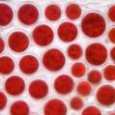
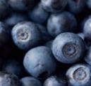
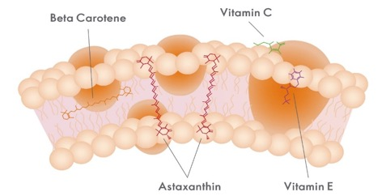
Astaxantina y Extracto de Arándanos
Cumple con
EC
Declaraciones autorizadas
- un amplio espectro de antioxidantes para ayudar a proteger contra el estrés oxidativo
4 powerful antioxidants
Benefits
Uno de los antioxidantes más poderosos de la naturaleza.
Vitamin
C
Vitamin
E
Astaxantina natural
Carotenoide liposoluble
Arándano
fitonutrimentos
Vitamina C
Vitamina soluble en agua
Vitamin E
Vitamina liposoluble
Protege toda la membrana celular.
“De adentro hacia afuera”
Notes:
SCRIPT:
The Astaxanthin & Bilberry Extract is a combination of powerful antioxidants that help to protect your cells from excessive oxidative stress.
[CLICK] Antioxidants help protect the cell membrane from oxidative stress in different ways.
Natural astaxanthin is a carotenoid that is fully absorbed and transported to all tissues in the body. It has a unique ability to span the entire cell membrane and protect both the inner and outer layer, which is why it is one of nature’s most powerful antioxidants.¹
Vitamin C is a water-soluble vitamin that protects the outer layer of the cell membrane. It has many beneficial effects such as supporting the immune system and protect cells from oxidative stress. But it also contributes to the reduction of tiredness and fatigue and normal collagen formation for the normal function of blood vessels, bones, cartilage, gums, skin and teeth. ³
Vitamin E is a fat-soluble vitamin that also serves as an antioxidant and helps protect the inner layer of the cell membrane from oxidative stress. ³
[CLICK] According to the European Commission authorised nutrition and health claims, this product serves as an antioxidant and is beneficial for your skin.³
So as you can imagine, when you take this combination of powerful antioxidants it helps to combat the harmful effects of oxidative stress by protecting the body’s cells from the inside out.
References:
Nishida Y, Yamashita E, Wataru M. Quenching activities of common hydrophilic and lipophilic antioxidants against singlet oxygen using chemiluminescence detection system. Carotenoid Science. 2007:11;16-20. doi: 10.11501/10996240.
Bornsek SM, Ziberna L, Polak T, Vanzo A, Ulrih NP, Abram V, Tramer F, Passamonti S. Bilberry and blueberry anthocyanins act as powerful intracellular antioxidants in mammalian cells. Food Chem. 2012 Oct 15;134(4):1878-84. doi: 10.1016/j.foodchem.2012.03.092. Epub 2012 Mar 30. PMID: 23442633.
EFSA Panel on Dietetic Products, Nutrition and Allergies (NDA); Scientific Opinion on the substantiation of health claims related to vitamin C and reduction of tiredness and fatigue (ID 139, 2622), contribution to normal psychological functions (ID 140), regeneration of the reduced form of vitamin E (ID 202), contribution to normal energy-yielding metabolism (ID 2334, 3196), maintenance of the normal function of the immune system (ID 4321) and protection of DNA, proteins and lipids from oxidative damage (ID 3331) pursuant to Article 13(1) of Regulation (EC) No 1924/2006. EFSA Journal 2010;8(10):1815. [20 pp.]. doi: 10.2903/j.efsa.2010.1815.

Slide 50
Wellness Pack
Features
Multivitamínico y minerales
tableta
Astaxantina y extracto de arándano
cápsula
Omega 3
cápsula
12
vitaminas
EPA
150 mg
Por 2 cápsulas
Astaxantina natural
3 mg
10
minerales
Extracto de arándano
50 mg
DHA
100 mg
Por 2 cápsulas
Vitamina C
12 mg
Vitamina E
1.8 mg
Notes:
SCRIPT:
Let’s look at the different components of the Wellness Pack!
First, we have the Multivitamin & Mineral tablet containing 12 essential vitamins and 10 essential minerals.
Secondly, we have the Astaxanthin & Bilberry Extract capsule that contains a broad spectrum of antioxidants from natural astaxanthin (3mg), bilberries (50 mg) and vitamin C (12 mg) and vitamin E (1.8 mg).
And last but not least, we have the Omega 3 capsules containing the important fatty acids EPA - eicosapentaenoic acid – (150 mg/2 capsules) and DHA - docosahexaenoic acid – (100 mg/2 capsules).
Let’s now take a deeper look into these three separate supplements!

Slide 51
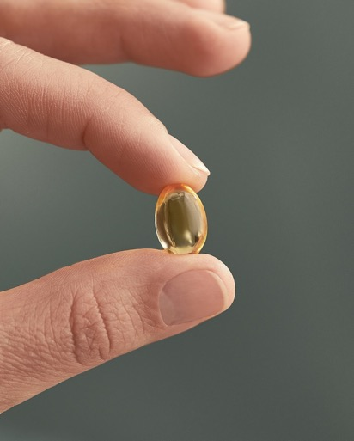




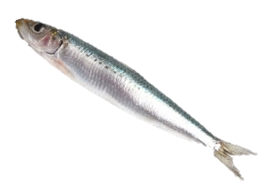
Omega 3
Cumple con
EC
Declaraciones autorizadas
- Aceite de pescado sostenible rico en los importantes ácidos grasos EPA y DHA.
Aceite de pescado procedente de poblaciónes sostenibles de pescado azúl, pequeño, fresco, entero y capturado en la naturaleza
Anchoas
Arenque
Caballa
Sardinas
Benefits
*
**
**
Cápsula de gelatina de pescado
Naturalmente rico en
ACEITE DE PESCADO PURO Y DE ALTA CALIDAD
PROCESO DE REFINAMIENTO DE 5 PASOS
EPA & DHA
5. ESTANDARIZACIÓN
4. DESODORIZACIÓN
3. INVERNACIÓN
2. BLANQUEO
El efecto beneficioso se obtiene con una ingesta diaria de 250 mg de EPA y DHA.
**El efecto beneficioso se obtiene con una ingesta diaria de 250 mg de DHA
1. NEUTRALIZACIÓN
Notes:
SCRIPT:
Our Omega 3 supplement is all fish. The capsule is made of fish gelatine and the omega 3 fish oil that we use is a natural triglyceride oil that is extracted from fresh, whole (including organs), wild-caught, small oily fish such as anchovies, herring, mackerel and sardines.
[CLICK] Small oily fish are naturally rich in the omega 3 fatty acids EPA and DHA. And small fish contain less toxins than big fish because they are short-lived and don’t feed on bigger fish.
The fish is sustainably harvested and certified by the Friend of the Sea organization – which is a certification of sustainable seafood products.
[CLICK] The fish oil undergoes a 5-step refinement process including neutralisation, bleaching, winterisation, deodorisation, and standardisation to ensure a pure, high-quality product without contaminants and off-flavours.
[CLICK] The formulation of our Omega3 capsules also complies with the European Commission authorised nutrition and health claims.¹
According to these claims EPA and DHA support heart*, brain**, and eye** health.
*The beneficial effect is obtained with a daily intake of 250 mg of EPA and DHA.
**The beneficial effect is obtained with a daily intake of 250 mg of DHA.
References:
EFSA Panel on Dietetic Products, Nutrition and Allergies (NDA); Scientific Opinion on the substantiation of health claims related to vitamin C and reduction of tiredness and fatigue (ID 139, 2622), contribution to normal psychological functions (ID 140), regeneration of the reduced form of vitamin E (ID 202), contribution to normal energy-yielding metabolism (ID 2334, 3196), maintenance of the normal function of the immune system (ID 4321) and protection of DNA, proteins and lipids from oxidative damage (ID 3331) pursuant to Article 13(1) of Regulation (EC) No 1924/2006. EFSA Journal 2010;8(10):1815. [20 pp.].
Neutralisation
The crude oil is heated and mixed with approx. 20% NaOH. After separation, soap residue is removed by washing the oil with hot water. The oil is finally dried under vacuum. Free fatty acids are removed by this step.
Bleaching
The oil is heated at reduced pressure. Citric acid and adsorbents are added. After mixing the oil is filtered to remove the adsorbents. Contaminants, residual soap and pigments are removed at this step.
Winterisation
The oil is gradually cooled down. When crystals have formed they are filtered off. The purpose of this step is to improve clarity during cool storage.
Deodorisation
The oil is heated to above 160 °C and sparged with steam under high vacuum for more than 30 minutes. This step will remove volatile components such as compounds that can cause off-flavour and contaminants.
Standardisation
A sample is drawn and analysed to specification.

Slide 52




¿Qué es único con nuestro Wellness Pack?
Cumplimos con los estrictos criterios de la UE.
Combinación única y efecto sinérgico.
Uno de los antioxidantes más poderosos de la naturaleza.
Aceite de pescado de origen sostenible
Sin azúcar añadida
Apoyo nutricional diario en un práctico sobre
Notes:
SCRIPT:
What is it that makes our Wellness Pack unique on the market?
If you recall, we abide to the strict EU criteria for nutrition and health claims.
[CLICK] It’s a unique combination of nutrients, precision-formulated for a synergetic effect on overall health and wellbeing for men and women respectively.
[CLICK] It contains one of nature’s most powerful antioxidants – natural astaxanthin.
[CLICK] The Omega 3 capsules contain sustainably sourced fish oil and is Friend of the Sea certified.
[CLICK] It contains no added sugar.
[CLICK] To summarise, the Wellness Pack is a daily nutritional support in a convenient sachet!

Slide 53
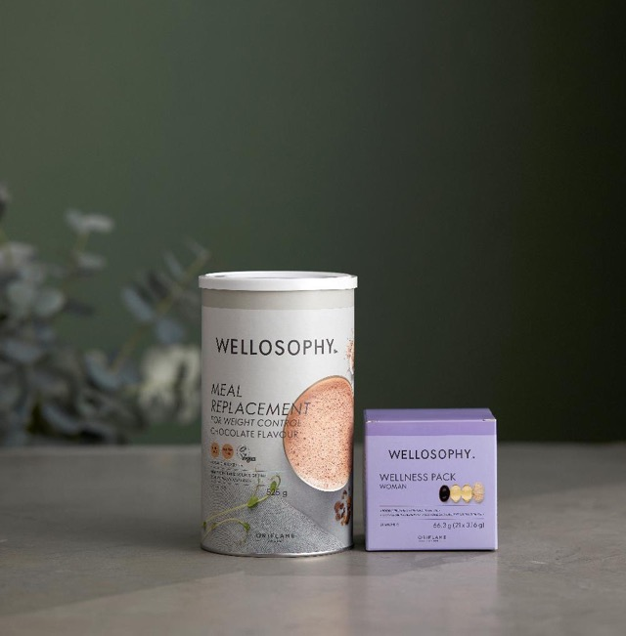
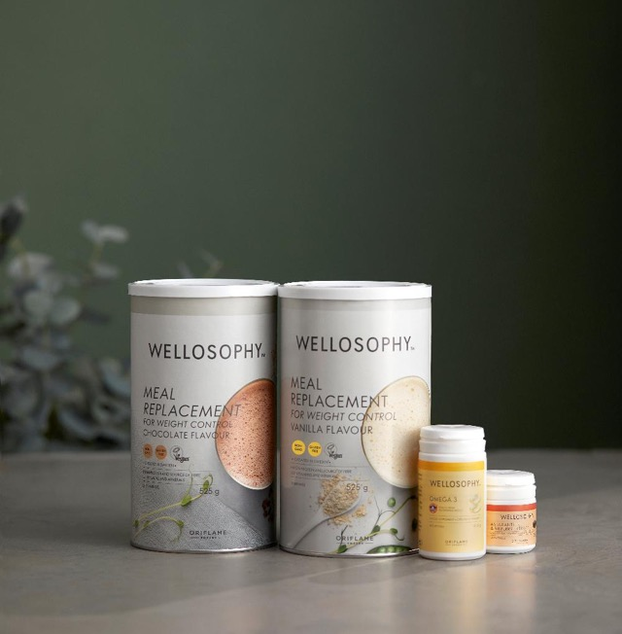
Cuando consumes 1 Meal Replacement,
¿Cómo combinar nuestro productos?
Cuando consumes 2 Meal Replacement ,
Puedes usar el Omega 3 y la Astaxantina & Extracto de Arándano
Puedes usar el Wellness Pack
Notes:
SCRIPT:
I want to add that you need to think before combining different mineral containing supplements.
When it comes to the Wellness Pack and it’s compatibility with the Meal Replacement for Weight Control.
[CLICK] There is no issue to combining the two if consuming one daily serving of the Meal Replacement.
[CLICK] But if you’re consuming two servings daily of the Meal Replacement for Weight Control, you should not combine it with the Wellness Pack.
The levels of certain minerals will be too high when taking both the Multivitamin & Mineral tablet from the Wellness Pack AND the Meal Replacement for Weight Control that provides 23 vitamins and minerals.
But you can still use the Omega 3 and Astaxanthin & Bilberry Extract capsules together with the Meal Replacement for Weight Control, irrespective of how many servings you consume.

Slide 54
Astaxantina & Extracto de Arándano
Con especial atención a la astaxantina
Notes:
SCRIPT:
Last but not least we have the Wellosophy Astaxanthin & Bilberry Extract.
You already know that it’s a powerful combination of different antioxidants, but do you know how antioxidants help to protect against oxidative stress?

Slide 55








El estrés oxidativo causa efectos negativos a la salud
Deterioro cognitivo
Radicales libres se acumulan en el cuerpo
Enfermedad cardiaca
Estrés oxidativo
Enfermedad de pulmón
Cáncer
Muerte prematura
Notes:
SCRIPT:
[CLICK] Oxidative stress is the accumulation of free radicals in the body that can cause harm in the long term.
Oxidative stress emerges when an imbalance exists between the formation of free radicals and the capability of cells to clear them.
Excessive oxidative stress can occur if you have a poor diet, excessive alcohol consumption, if you smoke, or are exposed to excessive sun exposure or air pollutants.
[CLICK] Did you know that oxidative stress harms cells in your entire body and is a burden to your skin, brain, heart, eyes and immune system?¹
And it has also been associated with the induction of several diseases, like cardiovascular and respiratory disease, and cancer. As well promoting the aging process.²
Reference:
Pisoschi AM, Pop A. The role of antioxidants in the chemistry of oxidative stress: A review. Eur J Med Chem. 2015 Jun 5;97:55-74.
Pizzino G, Irrera N, Cucinotta M, et al. Oxidative Stress: Harms and Benefits for Human Health. Oxid Med Cell Longev. 2017;2017:8416763.

Slide 56
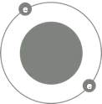
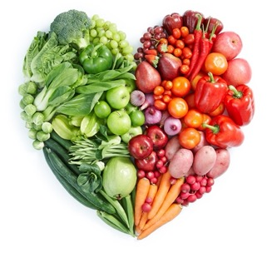
Los antioxidantes ayudan a combatir los radicales libres
e
e
e
La defensa antioxidante
de su cuerpo
Necesita la ayuda de los
Antioxidantes dietéticos
e
e
e
e
Los ANTIOXIDANTES
Neutralizan los radicales libres donando un electrón
e
e
e
MOLÉCULA ESTABLE con número par de electrones.
e
e
e
MOLÉCULA ESTABLE con número par de electrones
FREE RADICAL
with odd number of electrons
Defensa antioxidante respaldada por una dieta saludable
Notes:
SCRIPT:
Luckily, antioxidants help combat free radical damage and oxidative stress.¹
Free radicals are unstable molecules with an odd number of electrons that attack other molecules to steal their electrons which causes damage to the body’s cells and DNA.
[CLICK] Antioxidants help stop this chain reaction by donating an electron to the free radical thereby neutralizing it.
[CLICK] Our bodies have an antioxidant defense system, but if exposed to too many free radicals it can have trouble keeping up.
So, our bodies rely heavily on the support from antioxidants consumed through our diets.
References:
Péter S, Holguin F, Wood LG, et al. Nutritional Solutions to Reduce Risks of Negative Health Impacts of Air Pollution. Nutrients. 2015 Dec 10;7(12):10398-416.
Pisoschi AM, Pop A. The role of antioxidants in the chemistry of oxidative stress: A review. Eur J Med Chem. 2015 Jun 5;97:55-74.
Liu RH. Dietary bioactive compounds and their health implications. J Food Sci. 2013 Jun;78 Suppl 1:A18-25.

Slide 57
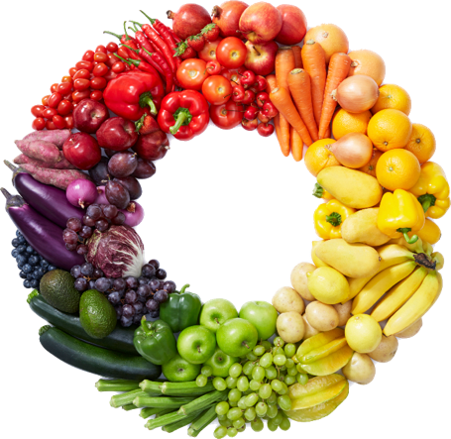
Comida rica en antioxidantes
Los antioxidantes ayudan a combatir el estrés oxidativo
e
Fenólicos
e
Capsaicina
e
Antocianidinas
El ANTIOXIDANTE
Neutraliza radicales libres
Flavonoides
Carotenoides
- Astaxantina
Resveratrol
¡La defensa antioxidante
de su cuerpo
necesita la ayuda
de los antioxidantes dietéticos!
¡Come el arcoiris!
Betaína
Hesperidina
Ácido elágico
Luteina
Curcumina
Zeaxantina
Alicina
Glucosinolatos
Indol
Notes:
SCRIPT:
Luckily, antioxidants help combat free radical damage and oxidative stress.¹
Our bodies have a built-in antioxidant defense, but if exposed to too many free radicals it can have trouble keeping up.
[CLICK] So our bodies rely heavily on the support from antioxidants consumed through our diets.
What types of food to focus on to optimise your antioxidant intake?
Well, foods such as fruits, berries, vegetables, legumes, algae, whole grains and nuts contain antioxidants.
[CLICK] Different colours represent different types of phytonutrients with antioxidant effect, that positively impact your health in many ways.²
That’s why it’s important to eat the rainbow
[CLICK] And one antioxidant in particular that has received a lot of praise is astaxanthin and you will learn more on why that is!
Reference:
Péter S, Holguin F, Wood LG, et al. Nutritional Solutions to Reduce Risks of Negative Health Impacts of Air Pollution. Nutrients. 2015 Dec 10;7(12):10398-416.
Liu RH. Dietary bioactive compounds and their health implications. J Food Sci. 2013 Jun;78(1):A18-25.

Slide 58
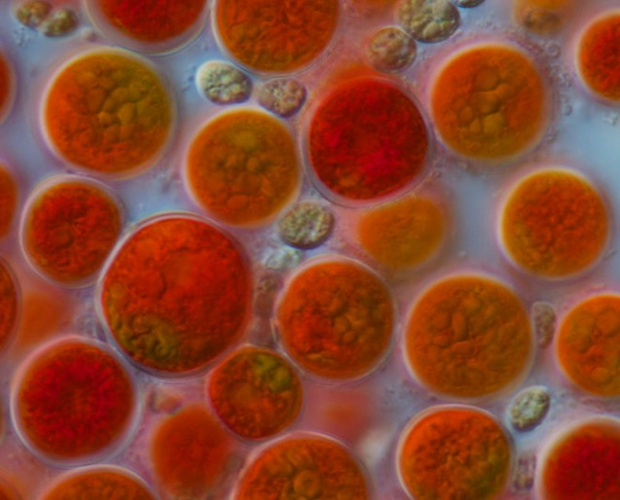


Natural o sintético
¿Qué es mejor?
Natural astaxantina
Astaxantina sintética
90x
Más fuerte
Haematococcus pluvialis
Notes:
SCRIPT:
Did you know that there are two types of astaxanthin?
Natural and synthetic.
So which version is best?
[CLICK] Natural astaxanthin is best!
It’s because it’s 90 times stronger (more potent/ powerful) than synthetic astaxanthin.¹
And not only is synthetic astaxanthin less potent, it is also not recommended for human consumption due to food safety concerns.²
[CLICK] The highest quality natural astaxanthin is obtained from the primary biological source – the algae Haematococcus pluvialis.¹
And this is what we use in our product.
Reference:
Nishida Y, Yamashita E, Miki W. Quenching Activities of Common Hydrophilic and Lipophilic Antioxidants against Singlet Oxygen Using Chemiluminescence Detection System. Carotenoid Science. 2007;11:16-20.
Morilla MJ, Ghosal K, Romero EL. More Than Pigments: The Potential of Astaxanthin and Bacterioruberin-Based Nanomedicines. Pharmaceutics. 2023;15(7):1828.

Slide 59
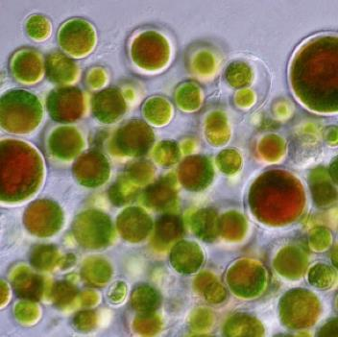

DE VERDE
Algae produce astaxantina natural de alta calidad
A ROJO
Algae es verde en la naturaleza
Algae se convierte rojo cuando se expone al estrés
Luz de sol | Falta de nutrición
Notes:
SCRIPT:
The highest quality astaxanthin is obtained from the primary biological source – the algae Haematococcus pluvialis.¹
The algae is green in nature and normal conditions and can be found in freshwater rock pools throughout the world.
But when the algae is under stressful conditions, such as harsh sunlight and lack of nutrition, it breaks down the chlorophyll (green color) and transforms into its red phase – producing natural astaxanthin - to protect itself.
It thereby creates a natural defense system against cell oxidation and damage.
This is what gives pink and red colour to salmon, flamingo, shrimp, and lobster because they consume the algae in their diet.
It needs to be consumed through the diet as animals can’t synthesize it.¹
References:
Morilla MJ, Ghosal K, Romero EL. More Than Pigments: The Potential of Astaxanthin and Bacterioruberin-Based Nanomedicines. Pharmaceutics. 2023;15(7):1828.

Slide 60

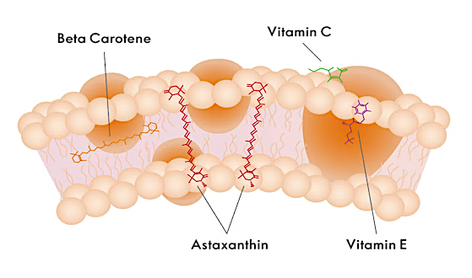
Astaxantina natural
Uno de los antioxidantes más poderosos de la naturaleza.
Astaxantina natural
protege la célula
de adentro hacia afuera
6000
más fuerte que la vitamina C
Propiedades antioxidantes y anti-inflamatorias.
“El Rey de los Antioxidantes”
Notes:
SCRIPT:
Natural astaxanthin is one of nature’s most powerful antioxidants, being 6000 times stronger than vitamin C for instance.¹
The reason why it is so powerful is that it’s fully absorbed and transported to all tissues in the body
[CKLICK] And compared to other antioxidants, astaxanthin has a unique ability to span the entire lipid bilayer of the cell membrane.
This means that it can protect against oxidative stress both inside and outside of the cell membrane.
In this way astaxanthin provides superior protection from the inside out.
In addition to its antioxidant abilities, astaxanthin has anti-inflammatory properties.
[CLICK] This is why it’s often referred to as “The King of antioxidants”.
Reference:
Nishida Y, Yamashita E, Miki W. Quenching Activities of Common Hydrophilic and Lipophilic Antioxidants against Singlet Oxygen Using Chemiluminescence Detection System. Carotenoid Science. 2007;11:16-20.

Slide 61







Beneficios de la astaxantina natural
¡Más de 60 ensayos clínicos en humanos!
Protección antioxidante | Propiedades anti-inflamatorias
Rendimiento muscular
Salud de piel
Salud visual
Función inmune
Protección contra la contaminación del aire
Vitalidad
Notes:
SCRIPT:
Astaxanthin has shown multiple health benefits in over 60 human clinical trials. ¹
As astaxanthin can impact all cells, both with antioxidant protection and anti-inflammatory effects, it gives all over health benefits.
Astaxanthin has many scientifically substantiated benefits such as;
[CLICK] Skin health
One of the best ways to support your skin is with a powerful antioxidant such as astaxanthin.
Astaxanthin provides protection from the inside out to the multiple layers of the skin, from the innermost (hypodermis), the mid-layer (dermis), through to the outermost layer (epidermis).
As astaxanthin provides a protective effect against UVA-induced oxidative stress from the sun, it reduces photoageing (skin damage caused by sun exposure).²
The appearance of wrinkles and skin elasticity can also be significantly improved with astaxanthin supplementation.³
Astaxanthin can also protect against seasonal skin deterioration (summer/winter conditions). ⁴
[CLICK] Muscle performance
Oxidative stress may occur during intense physical activity. Too much of it can have a negative impact on sports performance by reducing endurance, and activating the inflammatory response, which leads to muscle-tiredness and soreness.
Astaxanthin protects against free radicals in the muscles and helps inhibit muscle damage and inflammation as a result. ^{5, 6}
[CLICK] Immune function
Our immune system is made up of a network of cells, tissues and organs.
Immune cells are particularly sensitive to oxidative stress, which may slow immune defence.
As astaxanthin provides both antioxidant and anti-inflammatory benefits, supplementation with astaxanthin has been shown to improve immune response. ⁷⁻⁸
[CLICK] Eye health
Overtime, eyes are also affected by oxidative stress.
A key feature of astaxanthin is that it can pass through the blood-brain barrier. From there it can cross the blood-retinal barrier where it can provide antioxidant benefits to the eye.
Research has shown that astaxanthin can improve eye fatigue and strain as well as Computer Vision Syndrome (CVS). CVS is a temporary condition that can result from focusing the eyes on a computer screen for prolonged periods. CVS symptoms include fatigue, blurred vision and itchy eyes. ⁹⁻¹⁰
[CLICK] Vitality
Studies have shown that astaxanthin can help reduce both mental and physical tiredness and fatigue. ¹¹⁻¹²
[CLICK] Air pollution protection
Last but definitely not least, astaxanthin has been shown to help protect against the harmful effects of air pollution ¹³⁻¹⁴. And let’s see how it does that exactly.
References:
Stachowiak B, Szulc P. Astaxanthin for the Food Industry. Molecules. 2021;26(9):2666. doi: org/10.3390/molecules26092666.
Ito N, Seki S, Ueda F. The protective role of astaxanthin for UV-induced skin deterioration in healthy people—a randomized, double-blind, placebo-controlled trial. Nutrients. 2018;10(7):817.
Tominaga K, Hongo N, Karato M, et al., Cosmetic effects of astaxanthin for all layers of skin. Food Style. 2009;13(10):25-9.
Tominaga K, Hongo N, Fujishita M, et al. Protective effects of astaxanthin on skin deterioration. J Clin Biochem Nutr. 2017;61(1):33-9. doi:10.3164/jcbn.17-35
Djordjevic B, Baralic I, Kotur-Stevuljevic J, et al. Effect of astaxanthin supplementation on muscle damage and oxidative stress markers in elite young soccer players. J Sports Med Phys Fitness. 2012;52(4):382–92.
Earnest CP, Lupo M, White KM, Church TS. Effect of astaxanthin on cycling time trial performance. Int J Sports Med. 2011 Nov;32(11):882-8. doi: 10.1055/s-0031-1280779.
Park JS, Chyun JH, Kim YK, et al. Astaxanthin decreased oxidative stress and inflammation and enhanced immune response in humans. Nutr Metab (Lond). 2010 Mar 5;7:18. doi:10.1186/1743-7075-7-18
Baralic I, Andjelkovic M, Djordjevic B, , et al. Effect of astaxanthin supplementation on salivary IgA, oxidative stress, and inflammation in young soccer players. Evid Based Complement Alternat Med. 2015;2015:1–9. doi:10.1155/2015/783761
Shiratori K, Ohgami K, Nitta T, et al. Effect of astaxanthin on accommodation and asthenopia–Efficacy identification study in healthy volunteers. J Clin Therap Med. 2005;21(5):543-56.
Nitta T, Ohgami K, Shiratori K, et al. Effects of astaxanthin on accommodation and asthenopia–Dose finding study in healthy volunteers. J Clin Therap Med. 2005;21(6):637-50.
Hongo N. Randomized controlled trial of the anti-fatigue effects of astaxanthin on mental and physical loads simulating daily life. J Clin Ther Med. 2016 Jul;32(7):277-91.
Imai A, Oda Y, Ito N, et al. Effects of Dietary Supplementation of Astaxanthin and Sesamin on Daily Fatigue: A Randomized, Double-Blind, Placebo-Controlled, Two-Way Crossover Study. Nutrients. 2018 Feb 28;10(3):281. doi: 10.3390/nu10030281.
Wang T, Liu Y, Zhou Y, et al. Astaxanthin protected against the adverse effects induced by diesel exhaust particulate matter via improving membrane stability and anti-oxidative property. J Hazard Mater. 2023 Aug 15;456:131684. doi: 10.1016/j.jhazmat.2023.131684.
Morilla MJ, Ghosal K, Romero EL. More Than Pigments: The Potential of Astaxanthin and Bacterioruberin-Based Nanomedicines. Pharmaceutics. 2023;15(7):1828. doi: 10.3390/pharmaceutics15071828

Slide 62

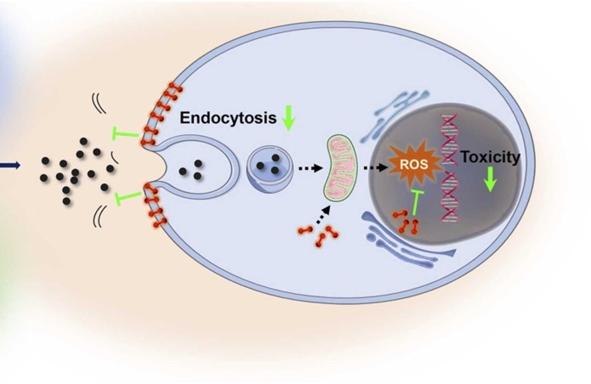



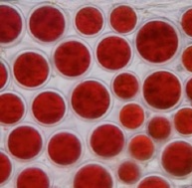
Astaxantina protege contra el daño de la contaminación del aire
Contaminantes de aire de partículas finas
Lung cell
NO_{x}
O₃
PM_{2.5}
Membrana celular
CO₂
Nucleus
Pb
Uptake of
air pollutants
SO₂
Mitochondria
Free
radicals
Astaxantina
1
2
DNA
3
1. Hace que se más difícil que los contaminantes del aire entren en la célula
3. Detiene el daño de los radicales libres al ADN y previene la muerte celular
2. Detiene la acumulación de radicales libres en la célula
Imagen adaptada de: Wang T, Liu Y, Zhou Y, et al. Astaxanthin protected against the adverse effects induced by diesel exhaust particulate matter via improving membrane stability and anti-oxidative property. J Hazard Mater. 2023 Aug 15;456:131684. doi: 10.1016/j.jhazmat.2023.131684.
Notes:
SCRIPT:
Here is a great illustration by the Chinese researcher Wang on how astaxanthin helps protect the cell against air pollution damage. ¹⁻²
[CLICK] As I mentioned, astaxanthin offers antioxidant protection across the cell membrane. But if also makes it harder for pollutants to cross the cell membrane by protecting the cell membrane stability.
Astaxanthin also offers direct antioxidant protection to important functions within the cell.
[CLICK]The mitochondria is the powerhouse of the cell and during the energy production oxygen is used, which leads to an accumulation of free radicals. Astaxanthin neutralize these free radicals, thereby stopping their accumulation.
[CLICK] Astaxanthin helps prevent DNA damage. DNA contains the instructions needed for an organism to develop, survive and reproduce (genes). If DNA is damaged, the cell undergo cell death. Preventing DNA damage is therefore crucial for cell health and to prevent the progression of several diseases.
So astaxanthin really does offer excellent antioxidant protection against free radicals and the detrimental effects of oxidative stress.
Note: Something that is especially great with natural astaxanthin is that it is a very stable antioxidant, which means it does not become a pro-oxidant even at high levels and continuous consumption. In other words, it never becomes toxic to the organism.
References:
Wang T, Liu Y, Zhou Y, et al. Astaxanthin protected against the adverse effects induced by diesel exhaust particulate matter via improving membrane stability and anti-oxidative property. J Hazard Mater. 2023 Aug 15;456:131684. doi: 10.1016/j.jhazmat.2023.131684.
Morilla MJ, Ghosal K, Romero EL. More Than Pigments: The Potential of Astaxanthin and Bacterioruberin-Based Nanomedicines. Pharmaceutics. 2023;15(7):1828. doi: 10.3390/pharmaceutics15071828

Slide 63






¿Qué es único con nuestra Astaxantina & Extracto de Arándano?
¡Cumplimos con los estrictos criterios de la UE!
4 diferentes antioxidantes
Uno de los antioxidantes más poderosos de la naturaleza.
Ingredientes de origen natural
Sin azúcar añadida
Combination of
Astaxanthin
Billberry
Vitamin
C
Vitamin
E
un amplio espectro de antioxidantes para ayudar a respaldar la lucha de su cuerpo contra el estrés oxidativo
Notes:
SCRIPT:
What is it that makes our Astaxanthin & Bilberry Extract unique on the market?
If you recall, we abide by the strict EU criteria for nutrition and health claims!
[CLICK] It’s a combination of 4 different sources of antioxidants.
[CLICK] With one of nature’s most powerful antioxidants – natural astaxanthin.
[CLICK] It’s with natural origin ingredients.
[CLICK And it doesn't contain any sugar!
[CLICK] To summarise, the Astaxanthin & Bilberry Extract is a daily food supplement with a broad spectrum of antioxidants to help support your body’s fight against oxidative stress from the inside out.

Slide 64




Razones para amar
Más de 15 años de experiencia en bienestar
Marca de estilo de vida holística y saludable
Productos de alta calidad basados en estándares europeos.
Asesoramiento, educación y apoyo de estilo de vida
EFICIENTE
SEGURO
RSPONSABLE
Respaldado por la ciencia más reciente
Notes:
SCRIPT:
So, what are the reasons to love Wellosophy – reasons that we can be proud of!
[CLICK] We have more than 15 years of experience, because our wellness category was born already in 2008.
[CLICK] It’s a healthy holistic lifestyle brand, taking every aspect of health in consideration such as;
Good nutrition
Physical activity
Quality sleep
And Social connection
[CLICK] Complemented with a portfolio of high-quality products that are performing, safe and responsible
[CLICK] Apart from high-quality products we help people change their daily habits by giving them healthy lifestyle advice, education and support through our Wellness Clubs.
[CLICK] Everything we do, from how we develop our products to how we create trainings, is underpinned by science.
That is reflected in how we work with our internal nutrition expertise – the Nutrition Council – and the external expertise – the Scientific Advisory Board – to be a thought leader in nutrition.

Slide 65
Te apoyamos en todo momento!
Notes:
SCRIPT:
We will support you all the way!

Slide 66


Notes:
SCRIPT:
We will hold your hands every step of the way and teach you everything we know through our Wellosophy Academy.

Slide 67

Wellosophy Advanced
Para quién
Contenido
Socios
Certificación Wellness Club Coach
Nivel 1 – Negocio & Bienestar
Nivel 2 – Control de Peso
Socios
Wellosophy Fundamentals
Entrenamiento de marca
Entrenamiento de negocio
Entrenamiento de producto
Consumidores y nuevos reclutas
Wellosophy Discovery
Wellosophy Sprints
Introducción a una vida saludable
Notes:
SCRIPT:
From the Wellosophy Discovery, Wellosophy Sprints, through the Fundamental trainings and all the way to the Advanced trainings.

Slide 68




Nutrition Center Of Expertise
Pronto…..
Artículos de expertos directamente de los científicos.
¡Más por venir!
Notes:
SCRIPT:
We will also be launching a Wellosophy Digital Centre of Expertise. All content is straight from our scientists to you and will include more information on our nutrition philosophy and our scientists.
Within the Education Hub you will find scientific articles on Skin Health, Gut Health and Emotional Health.
We will be constantly adding more content to this website and this year you can look forward to articles on Women’s Health and expert videos from our Nutrition Council and Scientific Advisory Board.

Slide 69

Lo puedes lograr con Wellosophy
Notes:
SCRIPT:
This is just the start! You can make it with Wellosophy!

Slide 70
¡Gracias!
Notes:
SCRIPT:
Thank you so much for joining today!

Slide 71

Preguntas y respuestas

